Slide 1
Electronic Transport in Semiconductors (Four Probe Resistivity and Hall Measurement)
Dr. Girish Chandra Tewari
Department of Chemistry and Material Science
Aalto University
24-03-2025

Slide 2
Learning outcomes
Why semiconductors
Well-known semiconductors
Theory of semiconductor physics
Basic idea of doping (p-type and n-type)
Resistivity of semiconductors
Measurement of resistivity
Hall effect and measurement

Slide 3
Semiconductors
Semiconductor applications
The Wide choice to alter the physical properties (example: high to low electrical conductivity, optical materials covering from UV to far infrared applications) Ultra-fast response times Multi-functional (source, operation and detection) devices Tailoring opportunity, in such a way that the device allows to implement all sorts of information processing Boolean logics, signal amplifiers, store and retrieve information, processing, light source… many more
Computers, laptops Silicon (Si) MOSFETs, ICs, CMOS
Smart phones, Cell Phones, pagers Si ICs, GaAs FETs, BJTs
Storage devices (USB,CD players) AlGaAs and InGaP laser diodes, Si photodiodes
TV remotes, mobile terminals Light emitting diodes (LEDs)
Satellite dishes InGaAs MMICs (Monolithic Microwave ICs)
Fiber networks InGaAsP laser diodes, pin photodiodes
Traffic signals, car GaN LEDs (green, blue)
taillights InGaAsP LEDs (red, amber)
Air bags Si MEMs, Si ICs

Slide 4
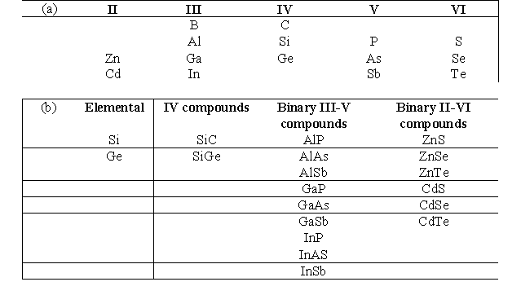
Semiconducting Materials
Intrinsic semiconductors – Si and Ge (column IV of periodic table)
Compound semiconductors –
Binary combinations of atoms of column III and column V and some atoms from column II and VI.
Ternary (three elements) compounds (GaAsP)
Quaternary (four elements) InGaAsP

Slide 5
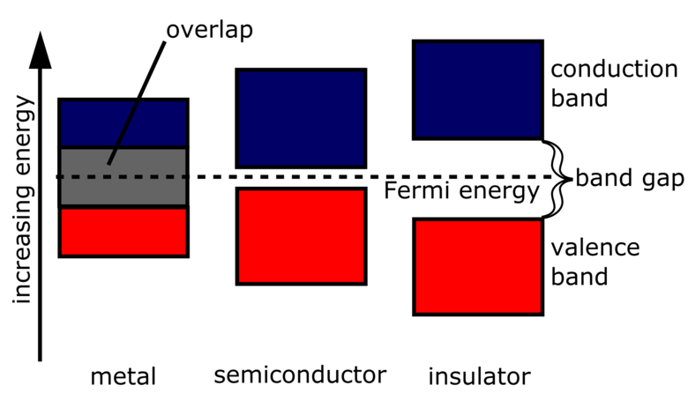
Introduction
Electrical Conductors (Metals) and Insulators
Electrical conductivity lie between Conductors (Metals) and Insulators.
Ex : Silicon and Germanium
Metal | Semiconductor | Insulator
Silver, platinum, copper gold.. etc | Silicon, Germanium, etc., | Teflon, Quartz, SiO₂ etc.,
Conductivity : 10⁶ to 1 (Ω-m)⁻¹ | 10⁻⁷ to 10³ | 10⁻⁷- 10⁻²⁵
Highest occupied energy bands are partially filled with electrons: | Valance Band Completely filled at low temperatures. Conduction band is empty
Band Gap (0eV < Eg <4 eV)

Slide 6
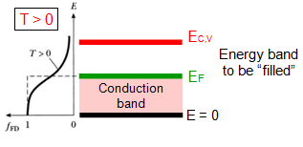
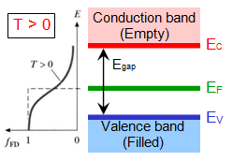
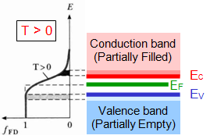
Metals
Highest occupied energy bands are partially filled with electrons, while above the Fermi energy level(E_{F}) all bands are empty. With a very small amount of energy lead the electrons go to the conduction band, leading to high conductivity. At T>0 electrons thermally excited and cross the barrier of E_{F}
Insulators
At T=0 Conduction band is completely empty and valence band is filled, leading to zero conductivity. Very big energy gap (E_{g}>4.5 eV)between conduction (E_{C}) and Valance (E_{V} ) bands, where E_{F} is in the middle. No thermal excitation and hence even higher temperature, conduction is zero
Semiconductors
At T=0, conduction band is empty, and valence band is filled, hence zero conductivity. E_{g} is < 4eV( Si: 1.17, Ge=0.74, GaAs= 1.52eV at T=0). At higher temperature electron thermal excitation does happen and hence the conductivity lies between metal and insulator

Slide 7
Type of Semicondutors
Intrinsic (Undoped):
Pure semiconductors are referred as intrinsic semiconductors
They consist almost equal number of holes and electrons which are generated by themal excitation at finite temperature
Zero Kelvin they behave like insulators
(2)Extrintrinsic (Doped):
Addition of impurities in controlled amounts would take semiconductor performance into new dimensions
Adding a small number of electrons (or holes) would dramatically change the transport properties of intrinsic semiconductor
Effect of doping (addition of either electron acceptors or electron donors) will increase the densities of respective carriers and hence the change in the conductivity
Depending on the dopant, electrons or holes, the semiconductor may be an N-type or P-type.

Slide 8
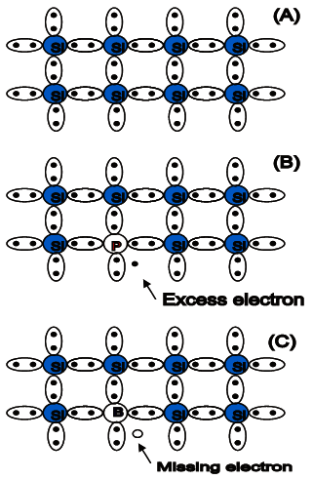
N-type dopant | P-type dopant
Called Donors | Called Acceptors
Group V impurities (e.g. Antimony, Phosphorous, Arsenic etc., ) | Group III impurities (e.g. Boron, Gallium and Indium)
Possess five valence electrons | Possess three valence electrons
Each atom covalently tries to bond with five lattice atoms | Each atom covalently bonds with 3 host atoms
Leaves an excess electron for every impurity atom in group IV matrix | Leaves unmade bond constitutes an excess hole for every impurity atom in group IV matrix
When doped with the semiconductors then the semiconductor is known as n-TYPE semiconductor | When doped with the semiconductors then the semiconductor is known as p-TYPE semiconductor
Electrons dominate the conduction process (majority carriers) | Holes dominate conduction processe
Pure silicon
N-type
doping
P-type
doping

Slide 9
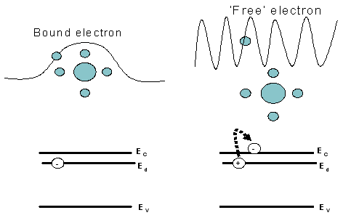
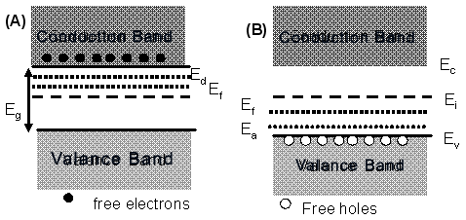
(A) n-type and (B) p type doped semiconductor
N-type:
The impurity atom is strongly bonded into the crystalline structure
Additional electron is loosely bounded, and therefore it behaves more like a free-electron
In the band diagram, the energy levels of these donor atoms lie in the forbidden gap, slightly below the conduction band of intrinsic semiconductor.
Donor energy levels (E_{d} ) in eV | Acceptor energy levels (E_{a} ) in eV
As= 0.054 ; P= 0.045 Sb= 0.043 | Al= 0.072 ; B= 0.045 Ga= 0.074 ; In=0.157
P-type:
The dopant is ready to accept one electron and thus called an Acceptor
The Acceptor energy level are close to valence band

Slide 10

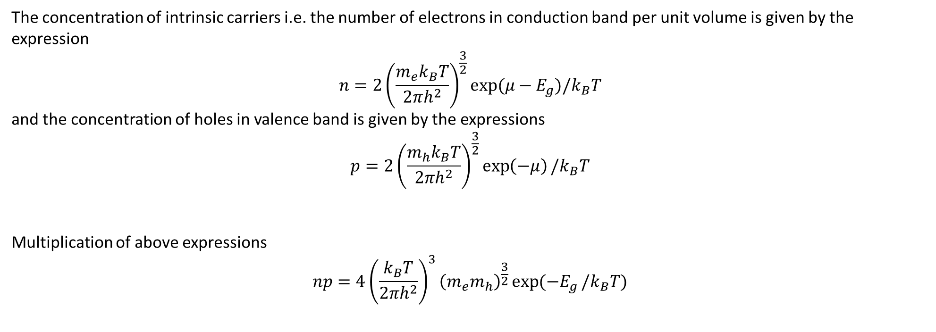
Temperature (T) Dependence of Resistivity (ρ) of Semiconductor
The concentration of intrinsic carriers i.e. the number of electrons in conduction band per unit volume is given by the expression
$$n=2{\left(\frac{m_{e}k_{B}T}{2πh^{2}}\right)}^{\frac{3}{2}}exp⁡(μ−E_{g}){/k}_{B}T$$
and the concentration of holes in valence band is given by the expressions
$$p=2{\left(\frac{m_{h}k_{B}T}{2πh^{2}}\right)}^{\frac{3}{2}}\exp\left(−μ\right)/k_{B}T$$
Multiplication of above expressions
$$np=4{\left(\frac{k_{B}T}{2πh^{2}}\right)}^{3}{\left(m_{e}m_{h}\right)}^{\frac{3}{2}}\exp{(−E_{g}}/k_{B}T)$$
This does not involve the Fermi level ($μ$) and is known as the expression of law of mass action. Where $m_{e}$ = Effective mass of an electron $m_{h}$= Effective mass of a hole, $k_{B}$ = Boltzamann's constant, $E_{g}$ = Bandgap, $T$ = Temperature in K

Slide 11


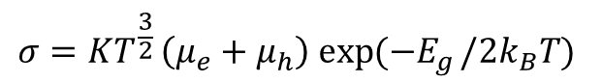
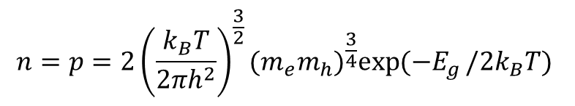
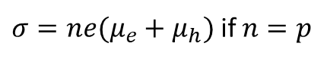


In case of intrinsic (highly purified) crystals, the number of electrons is equal to the number of holes, because the thermal excitation of an electron leave behind a hole in the valence band.
$$n=p=2{\left(\frac{k_{B}T}{2πh^{2}}\right)}^{\frac{3}{2}}{(m_{e}m_{h})}^{\frac{3}{4}}\exp{(−E_{g}}/{2k}_{B}T)$$
Thus, we see that the concentration of intrinsic carrier depend exponentially on $E_{g}/{2k}_{B}T$.
CONDUCTIVITY OF INTRINSIC SEMICONDUCTOR
The electrical conductivity will be the sum of the contributions of both electrons and holes
$$σ=(neμ_{e}+peμ_{h})$$
Where $e$ is the electron charge. $μ_{e}$ and $μ_{h}$ are the average velocities acquired by the electrons and holes in a unit electric field and known as mobilities.
$σ=ne(μ_{e}+μ_{h})$ if $n=p$
$$σ=KT^{\frac{3}{2}}\left(μ_{e}+μ_{h}\right) exp{(−E_{g}}/{2k}_{B}T)$$
Finally, where K is constant
Resistivity $ρ=1/σ=exp(E_{g}/{2k}_{B}T)/(KT^{\frac{3}{2}}\left(μ_{e}+μ_{h}\right)$)

Slide 12


The factor $T^{\frac{3}{2}}$ and the mobilities change relatively slow with $T$ compared with the exponential term, and hence the logarithm of resistivity ρ (=1/σ) varies linearly with $1/T$. The energy gap ($E_{g}$) may be determined from the slope of the curve
$${Log}_{e}\left(ρ\right)=\frac{E_{g}}{2k_{B}T}−{Log}_{e}K$$
For a temperature range in the middle of Figure , the resistivity remained relatively constant while the material heats. This accounts for the additional charge carriers found in extrinsic semiconductors that have already decreased the resistivity of the semiconductor below the value for the intrinsic counterpart. During the region of temperatures when the resistivity is not changing, the number of electrons being thermally excited to the conduction band is not yet large enough to influence the resistivity as much as the extrinsic doping has. Eventually the number of excited electrons becomes great enough to resume the intrinsic temperature dependent trend.
Resistivity and Hall Effect of Germanium at Low Temperatures Phys. Rev. Vol. 96, No. 5, 1954.

Slide 13
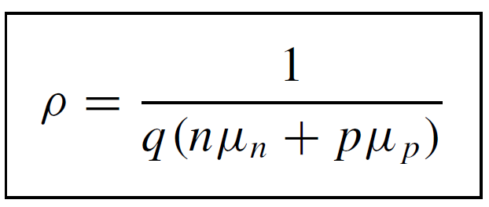
RESISTIVITY:
The resistivity depends on the free electron and hole densities n and p, and the electron and hole mobilities μn and μp according to the relationship
ρ can be calculated from the measured carrier densities and mobilities.
For extrinsic (doped) semiconductor in which the majority carrier density is much higher than the minority carrier density, it is generally sufficient to know the majority carrier density and the majority carrier mobility.
The carrier densities and mobilities are generally not known.
Hence, we must look for alternative measurement techniques, ranging from contactless, through temporary contact to permanent contact techniques.

Slide 14
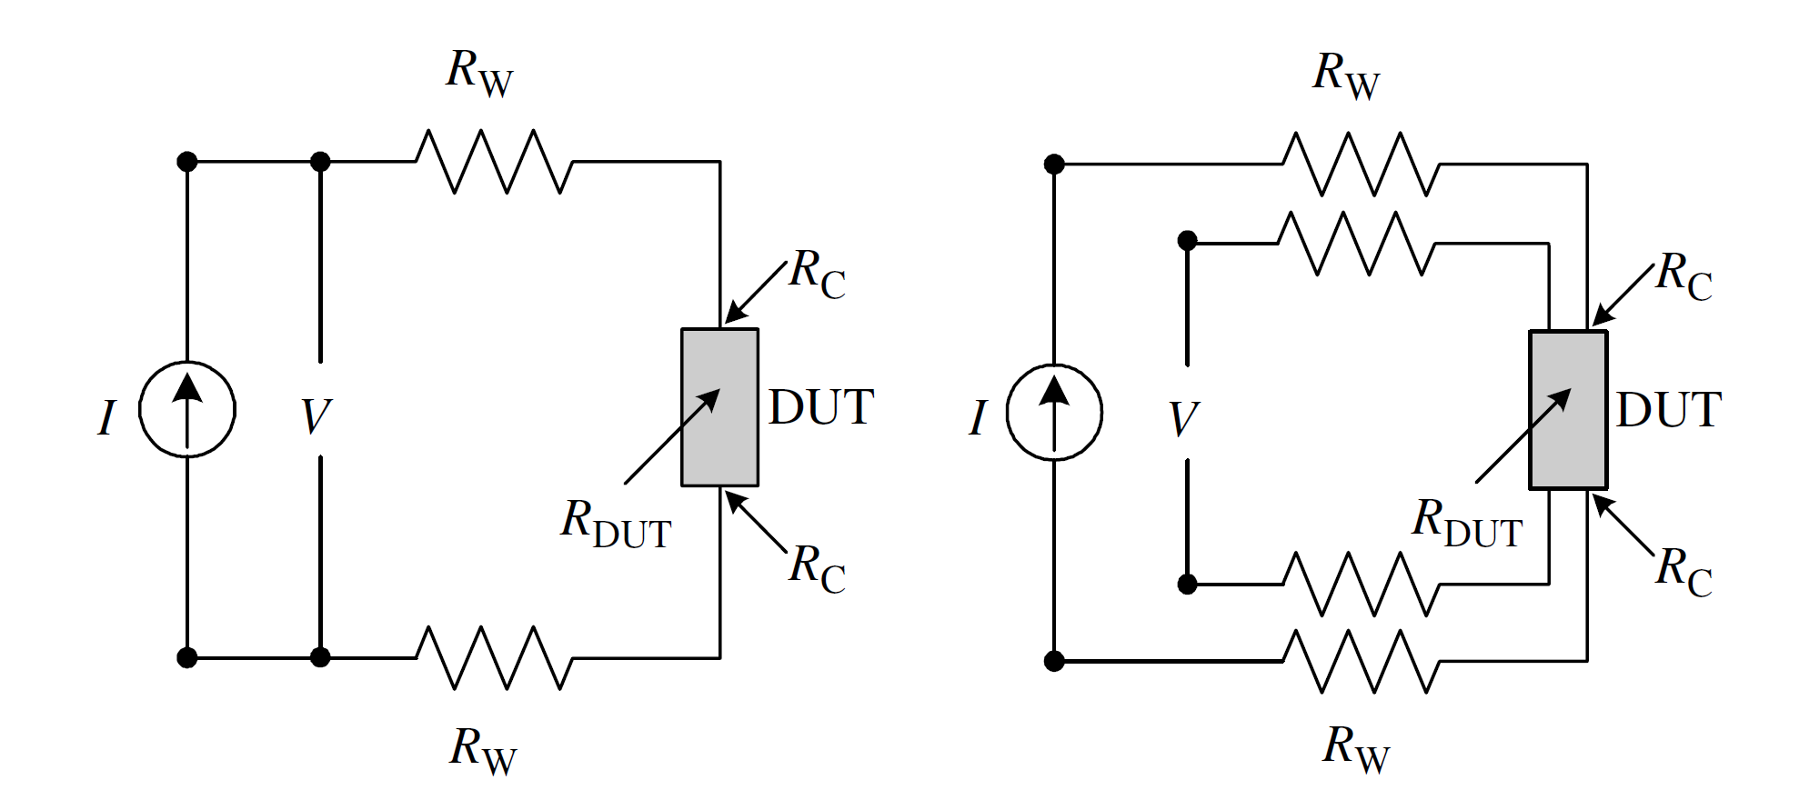

Method: (1) Two Contact (2) Four Contact
Two Contact: Consider the two-point probe or two-contact arrangement of Figure. Each contact serves as a current and as a voltage probe. We wish to determine the resistance of the device under test (DUT). The total resistance R_{T} is given by
where R_{W} is the wire or probe resistance, R_{C} the contact resistance, and R_{DUT} the resistance of the device under test.
Only two probes needed
Extracting the resistance (R_{DUT}) of device under test (DUT) is difficult and generally not correct for low R_{DUT} materials
Gives reasonable result for high R_{DUT} materials.

Slide 15
Four Contact:
The four-point probe is commonly used to measure the semiconductor resistivity
A current source is used to drive current across the samples
A high input impedance voltmeter is used to measure voltage across the samples

Slide 16
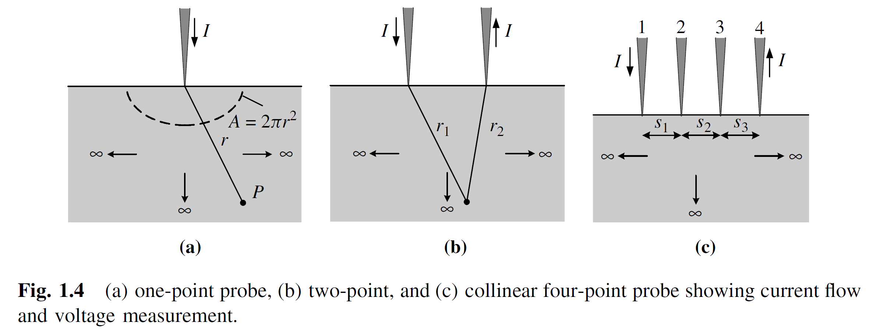
Resistivity Measurement From Four Point Probe
The electric field at certain point inside samples

Slide 17
The typical probe radii are in range of 30 to 500 μm and probe spacing should be 0.5 to 1.5 mm
Spacing vary for different sample dimensions
Normally semiconductor wafers are not semi-infinite in extent in either the lateral or vertical dimensions, so the equation must be corrected for finite geometries, thus for arbitrary shape sample
F corrects for probe location near sample edge, for sample thickness, sample dimeter, probe placement, and sample temperature. For very thin samples
The resistivity (ρ ) of the sample is given by
With equally spaced point contacts
For thin layers or thin films often, resistivity is given in terms of sheet resistance R_{sh} expressed in units of ohms per square

Slide 18
Resistivity of Arbitrary Shape Sample
The theoretical foundation of measurements on irregularly shaped samples is based on conformal mapping developed by van der Pauw.
He showed how the specific resistivity of a flat sample of arbitrary shape can be measured without knowing the current pattern, if the following conditions are met:
The contacts are at the circumference of the sample,
The contacts are sufficiently small,
The sample is uniformly thick
The surface of the sample is singly connected, i.e., the sample does not contain any isolated holes.
R_{12,34} is V₃₄/I₁₂, Current should be driven through 1 and 2 and voltage measured across 3 and 4
Resistivity is given by

Slide 19
Hall Effect
Discovered by Edwin Hall in 1879
The Hall effect is basic to solid-state physics and an important diagnostic tool for the characterization of materials – particularly semi-conductors.
It provides a direct determination of both the sign of the charge carriers, e.g. electron or holes, and their density in each sample.
E.H. Hall: "On a New Action of the Magnet on Electric Currents". American Journal of Mathematics vol 2, 1879, p.287-292

Slide 20
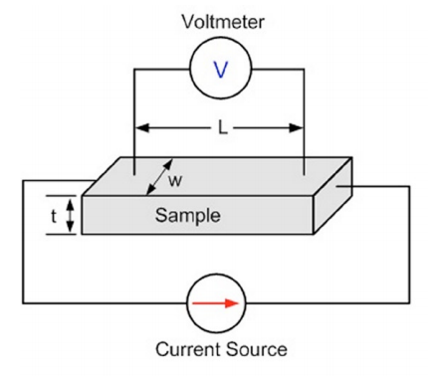
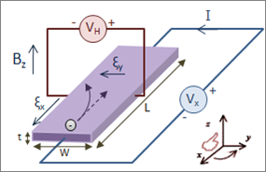
Resistivity Measurement
Hall Measurement
V_{H}=R_{H} I*B/t, R_{H} Hall coefficient
R_{H}=1/(n*e), n is charge carrier
density and e is electronic charge
n= 1/(R_{H}*e)
Ohm’s Law V=I*R
R=V/I
R=ρL/(w*t)
So ρ=R(w*t)/L

Slide 21
Hall Coefficient

Slide 22
Germanium
Hall Effect
Evaluation of Band Gap Through Conductivity
The band gap E_{g}=0.727±0.001 eV
The carrier concentration was found N=8.41x10²⁰ m⁻³

